Slide 1
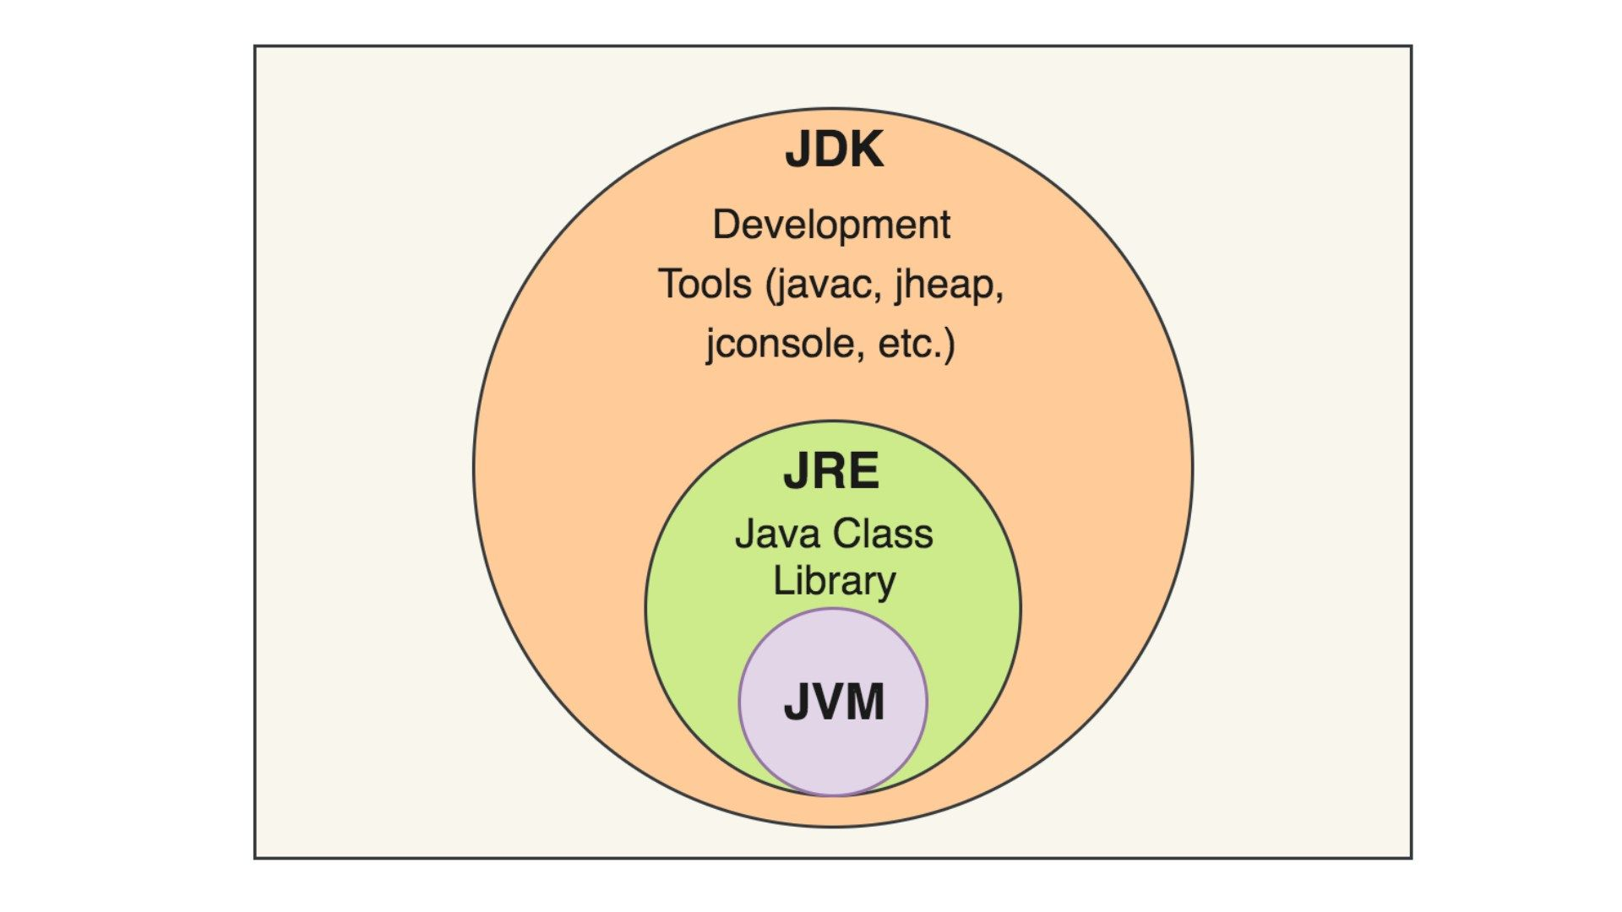
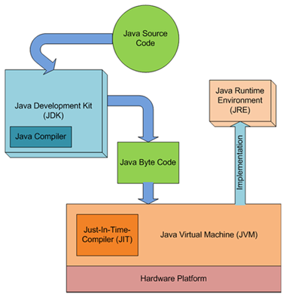

Slide 2
The Java Development Kit (JDK) is a software development environment used for developing Java applications and applets. It provides tools and libraries required for Java development, as well as the runtime environment for running Java programs.

Slide 3
Core Components of the JDK
Java Compiler
Java Virtual Machine (JVM)
Java Runtime Environment (JRE)

Slide 4
Java Compiler (javac)
javac is the Java Compiler that translates Java source code written in .java files into Java bytecode, which is stored in .class files.
Key Features of javac:
Input:
  Takes .java source files as input.
Output:
  Produces .class files containing platform-independent bytecode.

Slide 5
Command Syntax:
  Basic: javac MyProgram.java
  Compile all .java files in a directory: javac *.java
  Specify output directory: javac -d <output-dir> MyProgram.java
Error Reporting:
  Highlights syntax and compilation errors during the process.

Slide 6
Java Virtual Machine(JVM )
The Java Virtual Machine (JVM) is a key component of the Java platform that executes Java bytecode. It acts as an interpreter between the bytecode and the underlying hardware/OS.
Key Features of the JVM:
Platform Independence:
  JVM abstracts hardware and OS differences, allowing the same bytecode to run on any platform with a compatible JVM.

Slide 7
Execution:Converts bytecode to native machine code at runtime.
Memory Management:Manages memory allocation and garbage collection (automatic cleanup of unused objects).
Security:Includes a security manager to enforce restrictions (e.g., accessing the file system).

Slide 8
Execution:Converts bytecode to native machine code at runtime.
Memory Management:Manages memory allocation and garbage collection (automatic cleanup of unused objects).
Security:Includes a security manager to enforce restrictions (e.g., accessing the file system).

Slide 9
Lifecycle of JVM Execution:
Class Loading: The JVM loads .class files into memory.
Bytecode Verification: Ensures the bytecode adheres to Java's security and structure rules.
Execution: Bytecode is interpreted or compiled to native machine code by the JIT compiler.

Slide 10
Components of the JVM:
Class Loader:
  Dynamically loads Java classes.
Bytecode Interpreter:
  Executes bytecode instructions line by line.
Heap:
  Memory area for objects and class instances.
Method Area:
  Stores class-level data (e.g., method metadata, static variables).

Slide 11
Stack:Memory for method execution (local variables, call frames).
Garbage Collector:Automatically deallocate unused memory

Slide 12
JRE (Java Runtime Environment)
The Java Runtime Environment (JRE) is the runtime environment required to run Java applications. It includes the JVM and Java class libraries but does not include development tools like the compiler.
Key Features of the JRE:
Includes the JVM:Enables execution of .class files.

Slide 13
Java Libraries:Includes core Java APIs (java.lang, java.util, etc.) for building applications.
Platform-Specific:The JRE is tailored to specific operating systems and architectures.

Slide 14
Relationship Between javac, JVM, and JRE
Write Code:
  Developers write Java code in .java files.
Compile (javac):
  The javac compiler converts the source code into bytecode (.class files).
Run (JVM via JRE):
  The JVM, part of the JRE, loads and executes the bytecode

Slide 15
Features of java
Java is a versatile and powerful programming language widely used for developing various types of applications.
Object-Oriented
Java is based on the object-oriented programming (OOP) paradigm. Core concepts like objects, classes, inheritance, encapsulation, polymorphism, and abstraction are integral to Java.

Slide 16
Platform-Independent
Java is platform-independent due to its "Write Once, Run Anywhere" (WORA) capability. The code is compiled into bytecode, which can run on any device equipped with a Java Virtual Machine (JVM)
Simple
Java is designed to be easy to learn and use. Its syntax is straightforward and similar to C++, but without complexities like pointers and operator overloading.

Slide 17
Secure
Java provides a secure environment by avoiding direct memory access and offering built-in security features such as bytecode verification, class loaders, and a robust security manager.
Robust
Java emphasizes reliability with features like exception handling, automatic garbage collection, and strong memory management to avoid errors and crashes.

Slide 18
Multithreading
Java supports multithreading, allowing developers to build applications capable of performing multiple tasks simultaneously for better performance and efficiency.
Portable
Java's platform independence and the uniform behavior of its runtime environment make Java applications portable across operating systems and hardware.

Slide 19
High Performance
While Java is not as fast as lower-level languages like C++, its Just-In-Time (JIT) compiler and optimized runtime performance make it highly efficient for most use cases.
Distributed
Java facilitates the development of distributed systems through built-in APIs like RMI (Remote Method Invocation) and CORBA. It supports networking and internet-based applications seamlessly.

Slide 20
Scalable
Java is suitable for building small applications to large, enterprise-level systems due to its scalability and robustness.
Supports Development Frameworks
Java works with various frameworks like Spring, Hibernate, and Struts, making it easier to build complex and efficient applications.

Slide 21
Java is statically typed and also a strongly typed language because, in Java, each type of data (such as integer, character, hexadecimal, packed decimal, and so forth) is predefined as part of the programming language and all constants or variables defined for a given program must be described with one of the Java data types.

Slide 22
Data types in JAVA are of different sizes and values that can be stored in the variable that is made as per convenience and circumstances to cover up all test cases. Java has two categories in which data types are segregated
Primitive Data Type: such as boolean, char, int, short, byte, long, float, and double. The Boolean with uppercase B is a wrapper class for the primitive data type boolean in Java.
Non-Primitive Data Type or Object Data type: such as String, Array, etc.

Slide 23
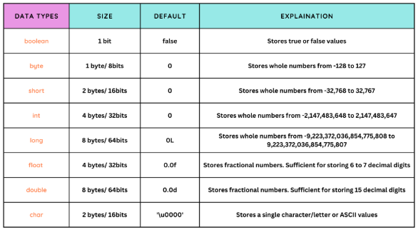

Slide 24
Non-Primitive (Reference) Data Types
The Non-Primitive (Reference) Data Types will contain a memory address of variable values because the reference types won’t store the variable value directly in memory. They are strings, objects, arrays, etc.

Slide 25
1. Strings
Strings are defined as an array of characters. The difference between a character array and a string in Java is, that the string is designed to hold a sequence of characters in a single variable whereas, a character array is a collection of separate char-type entities. Unlike C/C++, Java strings are not terminated with a null character.

Slide 26
2. Class
A Class is a user-defined blueprint or prototype from which objects are created. It represents the set of properties or methods that are common to all objects of one type.

Slide 27
Object
An Object is a basic unit of Object-Oriented Programming and represents real-life entities. A typical Java program creates many objects, which as you know, interact by invoking methods. An object consists of :
State : It is represented by the attributes of an object. It also reflects the properties of an object.
Behavior : It is represented by the methods of an object. It also reflects the response of an object to other objects.
Identity : It gives a unique name to an object and enables one object to interact with other objects.

Slide 28
Interface
Like a class, an Interface can have methods and variables, but the methods declared in an interface are by default abstract (only method signature, no body).
Interfaces specify what a class must do and not how. It is the blueprint of the class.
An Interface is about capabilities like a Player may be an interface and any class implementing Player must be able to (or must implement) move(). So it specifies a set of methods that the class has to implement.
If a class implements an interface and does not provide method bodies for all functions specified in the interface, then the class must be declared abstract.

Slide 29
Array
An Array is a group of like-typed variables that are referred to by a common name.
Since arrays are objects in Java, we can find their length using member length. This is different from C/C++ where we find length using size.
A Java array variable can also be declared like other variables with [] after the data type.
The variables in the array are ordered and each has an index beginning with 0.
The size of an array must be specified by an int value and not long or short.
The direct superclass of an array type is Object.

